Slide 1
SC462 - Elements of Synthetic Biology Professor – Manish K GUpta da-iict Subject : crispr – hiv Dhaval Prajapati Id :- 20401138

Slide 2

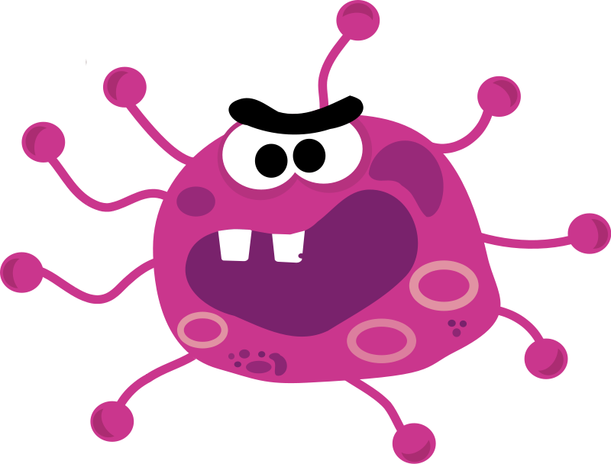
What is HIV ..??

Slide 3
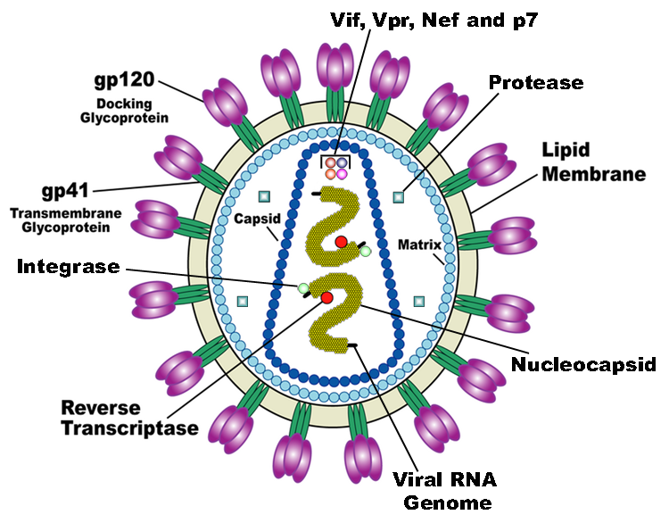
HIv (Human Indeficiency virus)

Slide 4

How it occurs ? Which are the modes of Transmission ?

Slide 5
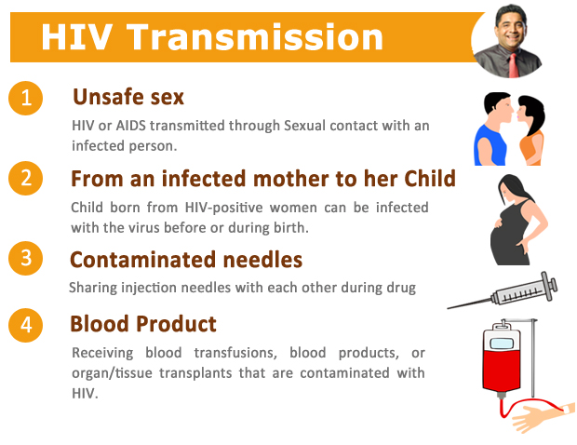

Slide 6
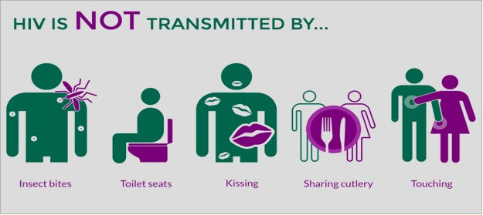
Myths….

Slide 7
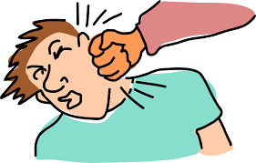
How it affects our body ?

Slide 8
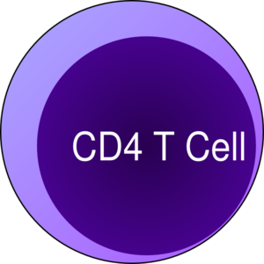
Cd4 protine and T-lymphocytes cell(cd4 T cells)
CD4 protein is stuck around the T – lymphocyte cell
Theses two things are very important for our Immun System.

Slide 9
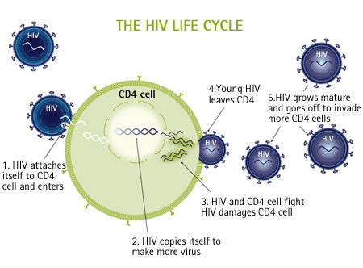
HIV Life cycle
-HIV virus Enter in Body
-Attack on CD4 T cells
- Start making copies of own by using CD4 T cells

Slide 10

Lets do some statics and analysis…

Slide 11
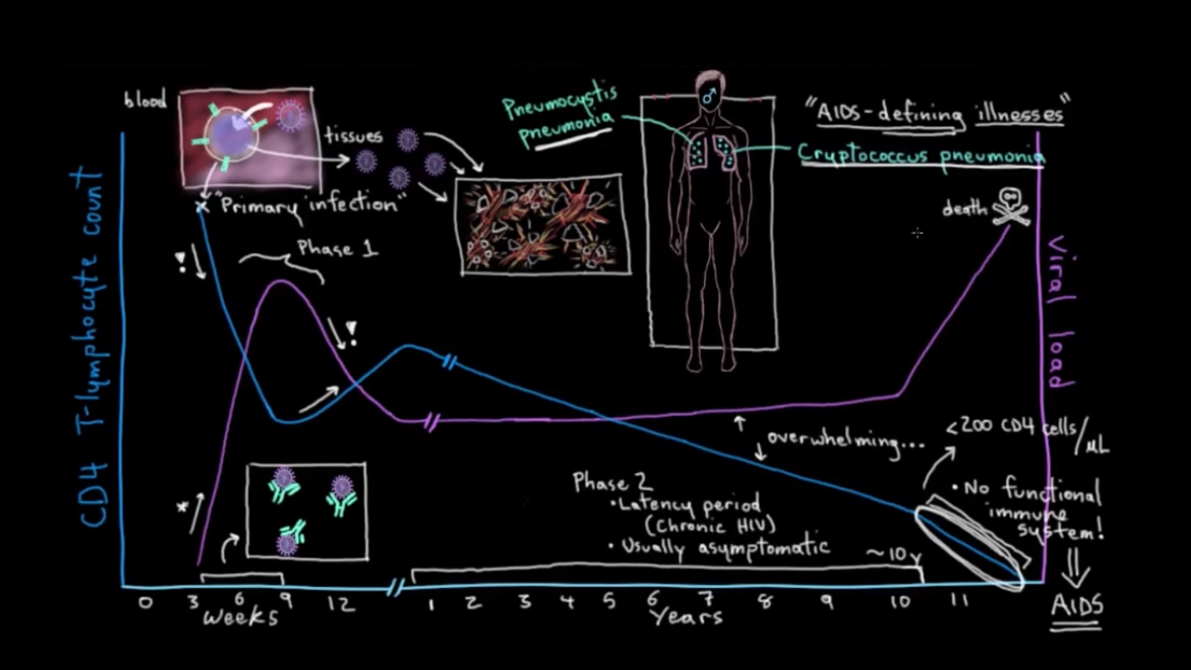

Slide 12


What is the solution ?

Slide 13
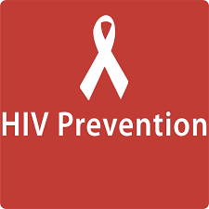

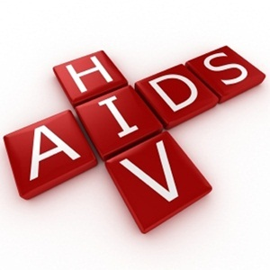
HIV Preventing Techniques

Slide 14
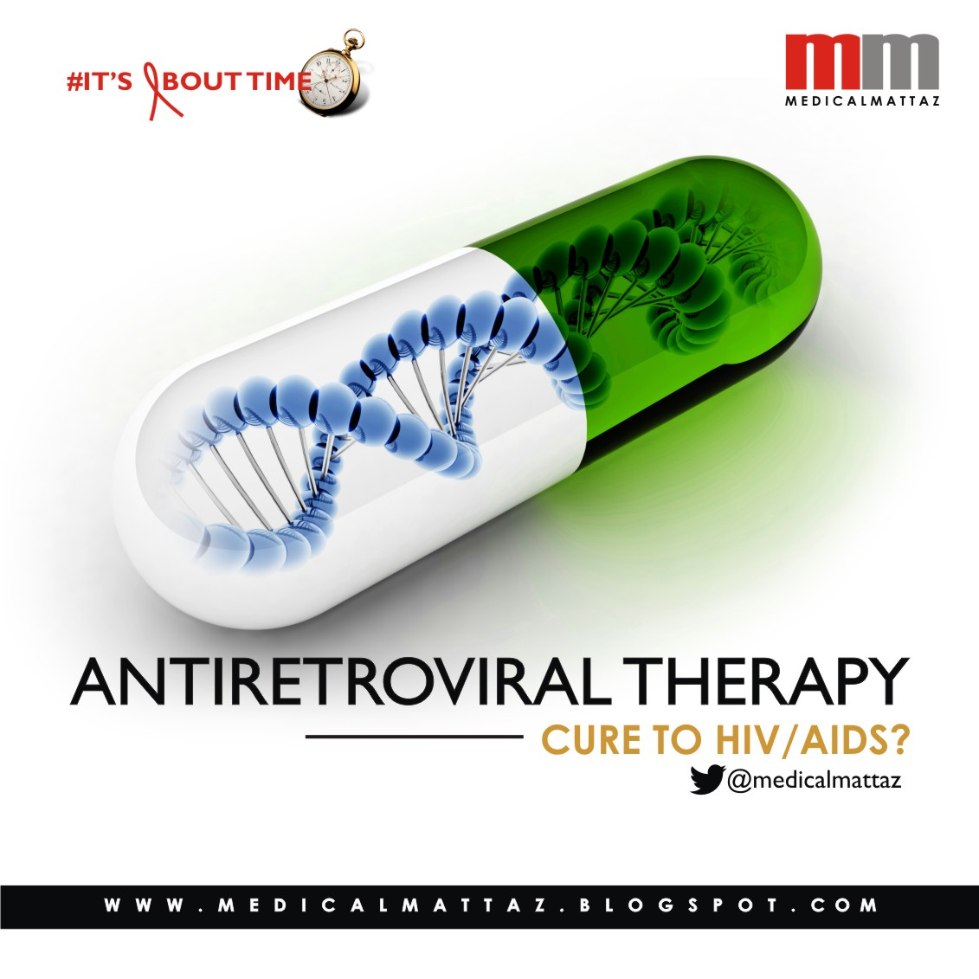
Antiretroviral Therapy (ART)
It is the combination of Antiretroviral Drugs.
There are Several types of Antiretroviral Drugs who can
reduce the rate of HIV different different way.
- Antiretroviral treatment reduces the HIV viral load in the blood, semen, vaginal fluid and rectal fluid to very low levels or you can say undetectable levels, decreasing the risk of onwards HIV transmission

Slide 15
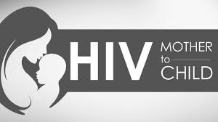
Treatment as prevention (TasP) for HIV : 1. Prevention of mother-to-child transmission (PMTCT) :-
Reduce the rate of HIV transmission from
mother to child

Slide 16
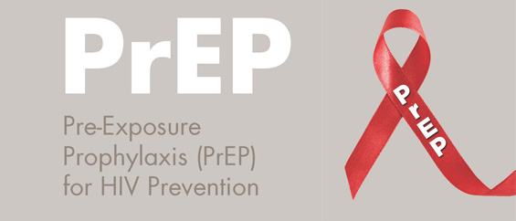
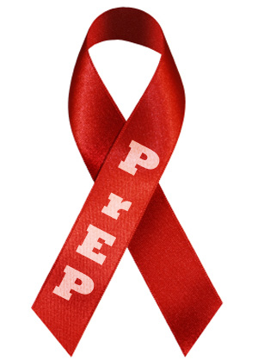
2. Pre-exposure prophylaxis (PrEP) :-
-For those people who has the chance to get HIV.
-In,2015 WHO has declared that t if Person has substantial risk of HIV infection then PrEP would be offered to that person.
- In past, it was for only some key affected population like sex workers, person who has sex with HIV infected person and people who inject drugs in their body.

Slide 17
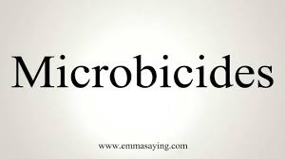
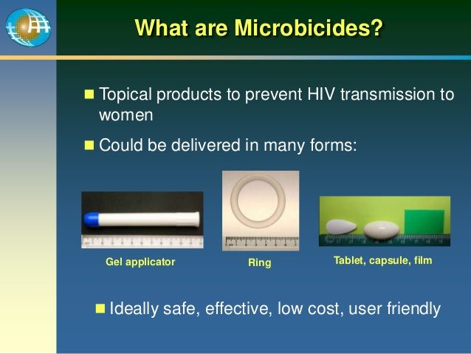
3. Microbicides
-These are gels or creams containing antiretroviral drugs that are applied to the vagina to help prevent HIV infection.

Slide 18
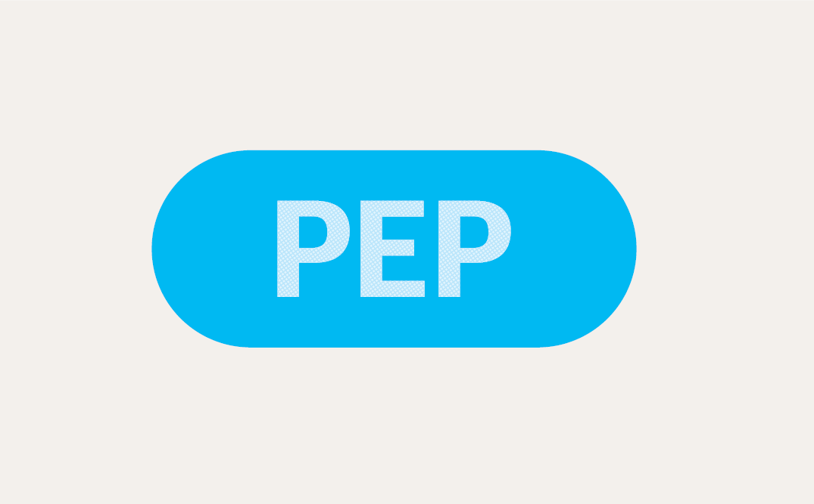
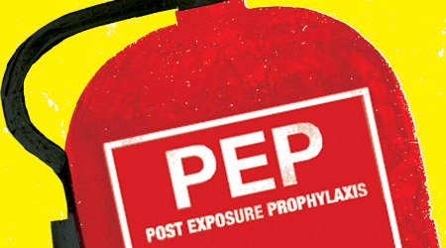
:- 4. Post-exposure prophylaxis (PEP)
-It is short-term antiretroviral treatment taken after possible exposure to HIV.
-Since 1998, Health Care workers have used it. Who were exposed to HIV-infected fluids
-Recently, This method has been used to treat those who may have been exposed during a single event (for example sexual assault, unprotected sex or sharing drug injecting equipment).

Slide 19
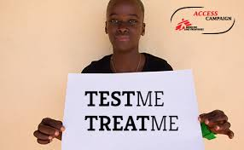
Test and treat strategies :-
This strategies are based on the premise that the rate of new HIV infections can be reduced by rolling out universal HIV testing in order to diagnose all people living with HIV, and initiate antiretroviral treatment regard less of CD4 count or viral load.
One case study which performed in south africa analised that the implementation of universal voluntary HIV testing for adults over 15 years old would decrease HIV prevalence to 1 %
Detail of Case Study :
Name : Test and Treat in Hlabsia
The first of five massive randomized studies into test and treat strategies took place between 2012 and 2016. ANRS 12249 was covering a poor rural area of KwaZulu-Natal, where three out of ten people are living with HIV which was the highest prevalence in South Africa. The main agenda of the research was to check the population impact of scaling up treatment as prevention, where By antiretroviral treatment (ART) is used to decrease individual’s viral load and thereby decrease the risk of onward HIV transmission.
Medical management of these areas was not so good thats why only 49%.

Slide 20
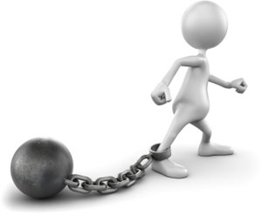
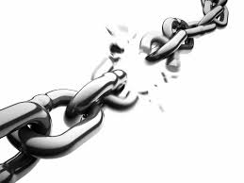
What are the Limitations …?? How can we over come that ??

Slide 21


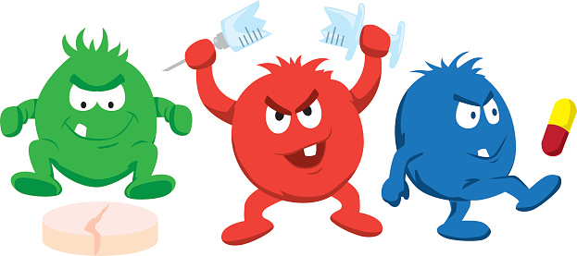
1. Treatment as prevention is not 100 persent effective 2. Regularity is important to its success 3. Multidrug-resistant HIV

Slide 22
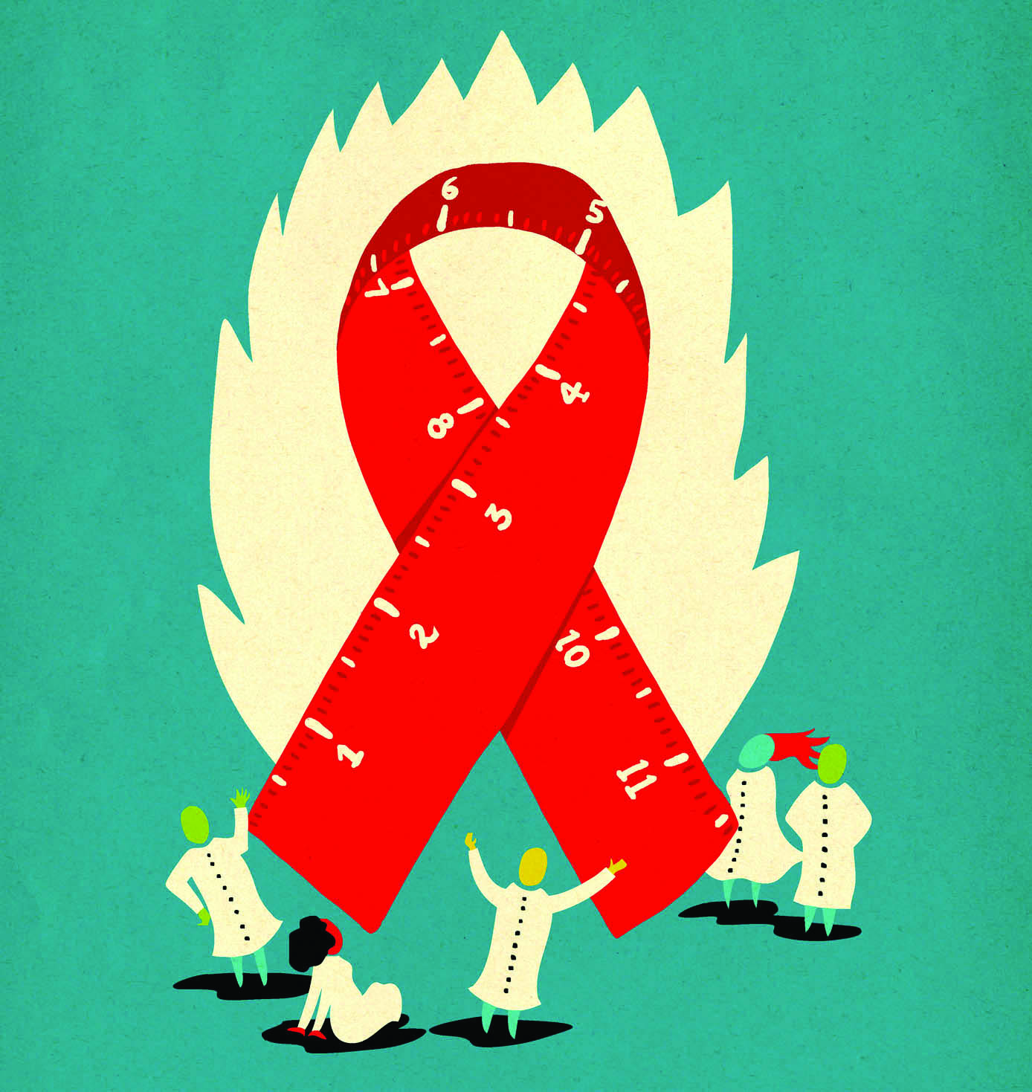

The future of treatment as prevention :-
- TasP has a lot of potential in decreasing population level rates of HIV transmission by increasing uptake of HIV testing, offering treatment and linking people to care.
Its effectiveness depends on the on the willingness and ability of people
Main Challenge is its implementation with limited resource. It's depends on the countries Medical system to provide effective treatment.
Overall, there is huge support for treatment as an HIV prevention measure. With only treatment we can not defeat this big giant called HIV.we also need to spread Social awareness among the People about HIV.

Slide 23
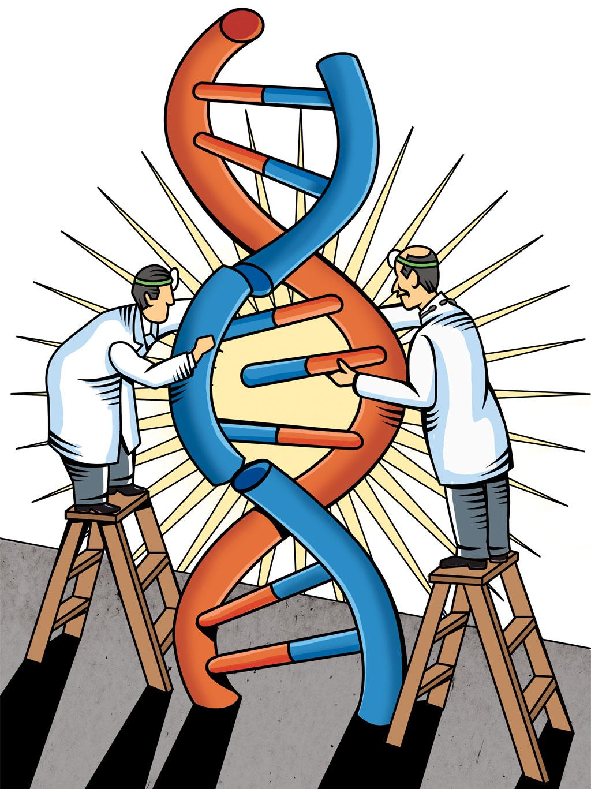
Genome editing with Engineered Nucleases:-
Genome editing, or genome editing with engineered nucleases (GEEN) is a type of genetic engineering in which DNA is inserted, deleted or replaced in the genome of a living organism using engineered nucleases, or ”molecular scissors.”
Genome editing systems:-
ZFNS(zinc-finger nucleases) :-
TALENs(Transcription activator-like effector nucleases) :-
3. CRISPR-Cas9 :-

Slide 24
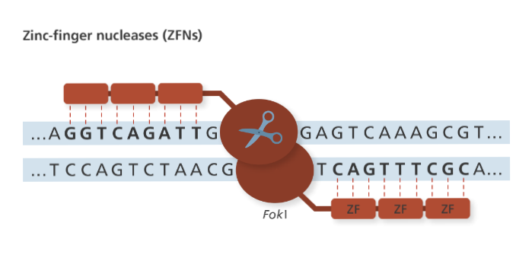
1. ZFNS(zinc-finger nucleases) :-
• ZNF has DNA-binding part , which is made of zinc-finger proteins.
• Each zinc-finger protein binds to different sequences of DNA. Different combinations of zinc-finger proteins bind with different sequences of DNA, But it is hard to predict without testing them first.
• The nuclease part of ZFNs is generally a FokI nuclease and it cuts the DNA.
• Two FokI molecules bind together to make a cut in the DNA, so this way a pair of ZFNs are made and one binds to each strand.

Slide 25
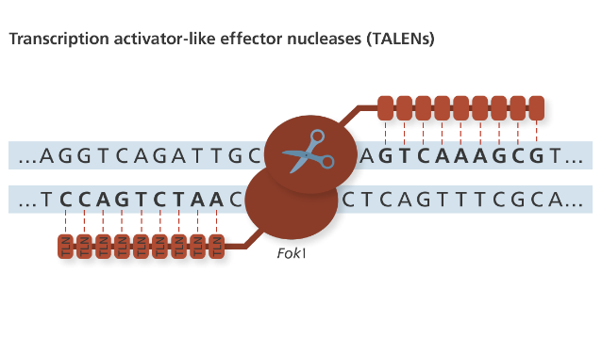
2. TALENs(Transcription activator-like effector nucleases) :-
• TALENs has DNA-binding domain, which is made of TALE(Transcription activator-like effector).
• There are four types of Binding domain,each domain for each DNA base. so they can be programmed to bind to specific DNA sequences much more easily than ZFNs.
• Same as ZFNs, the nuclease part of TALENs is generally FokI nuclease.
• Two FokI molecules must have to come together to do a cut in the DNA, so two TALENs can be maid, one TALENs binds with each strand.

Slide 26
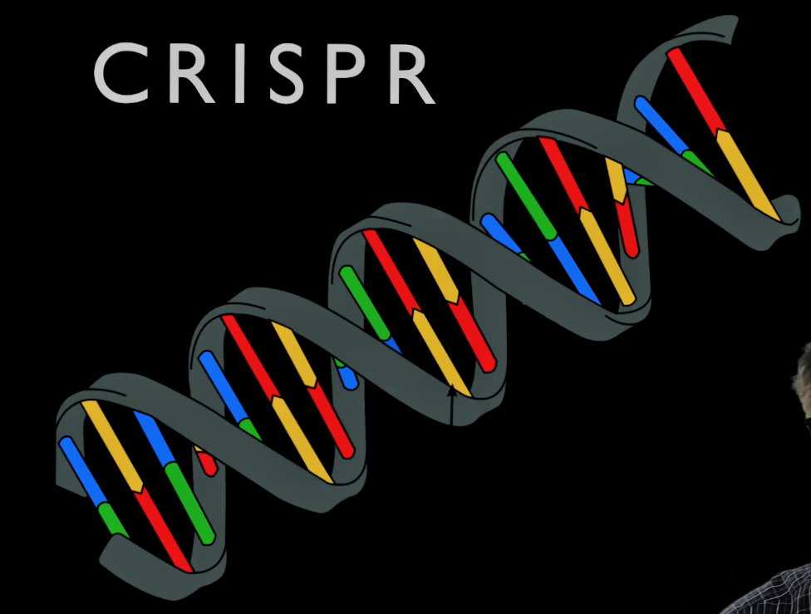
3. CRISPR/CAS9

Slide 27
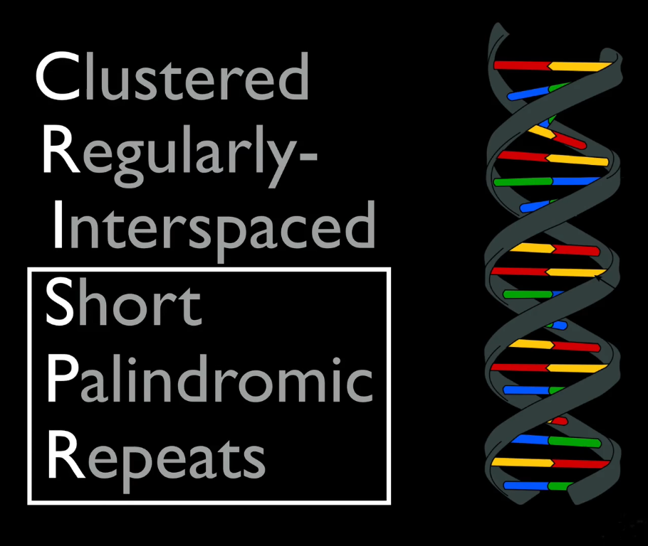

Slide 28
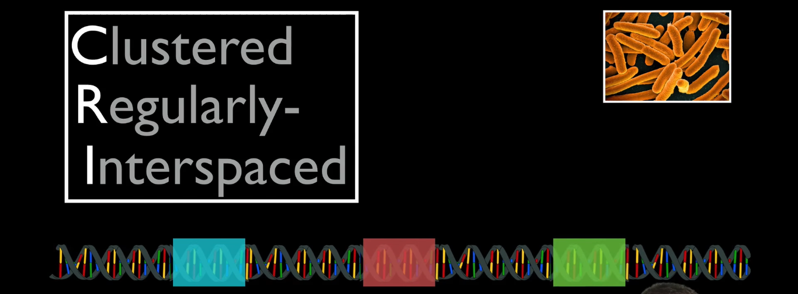

Slide 29
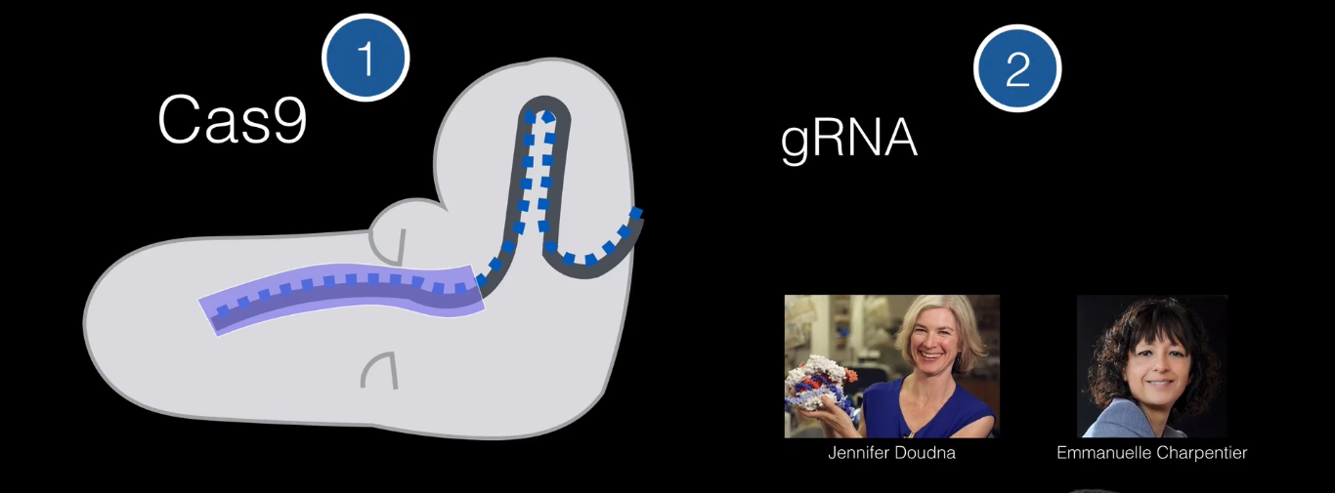

Slide 30
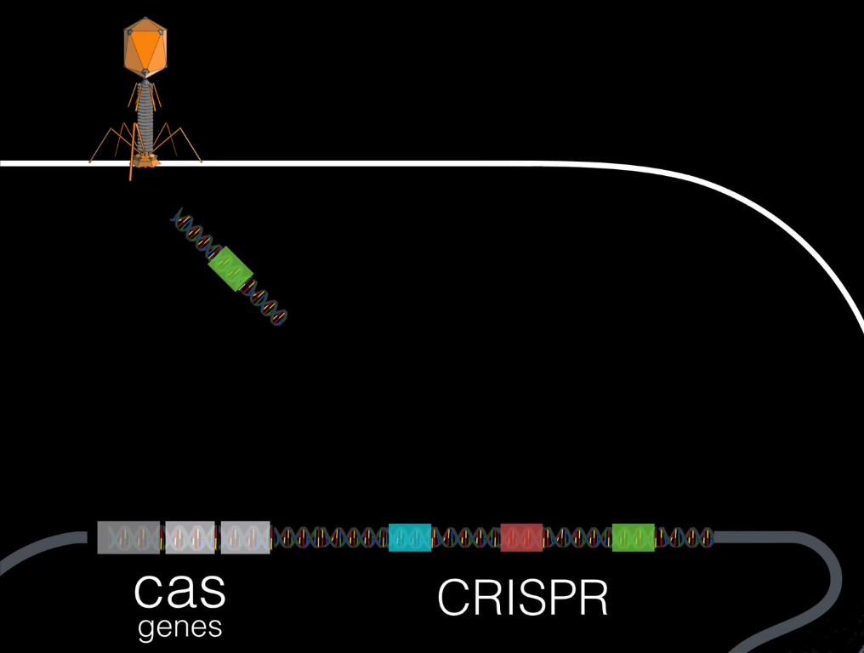

Slide 31
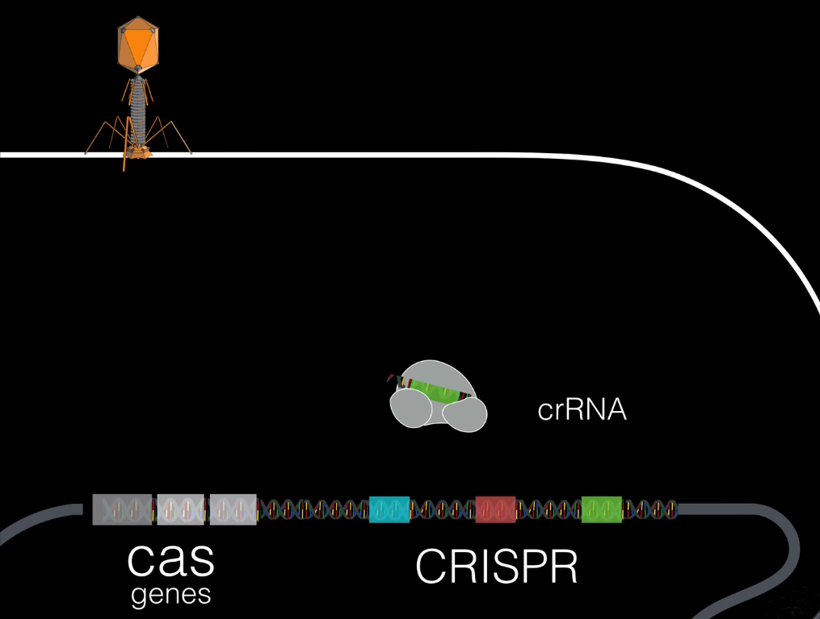

Slide 32
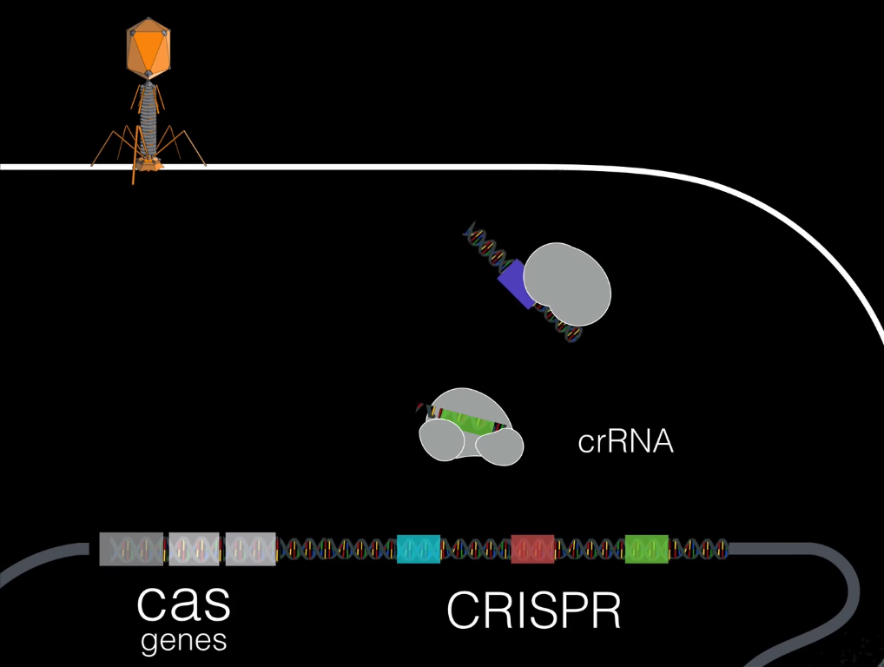

Slide 33
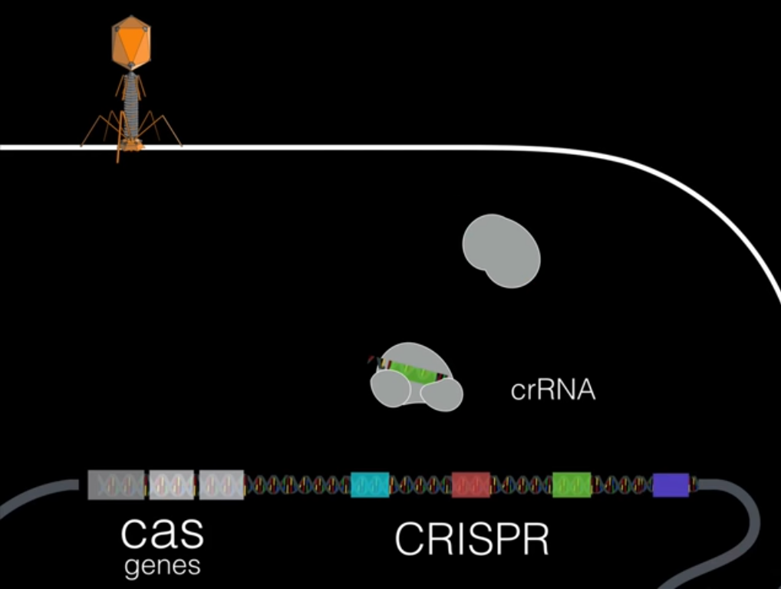

Slide 34

PROs and cons….

Slide 35
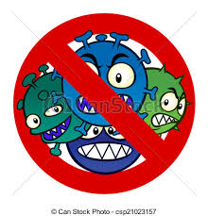

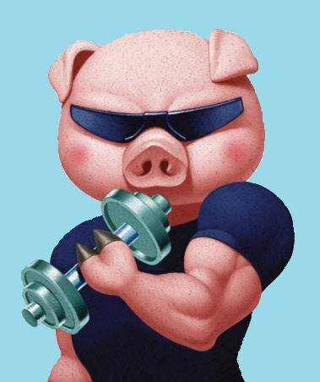
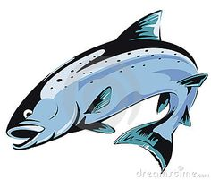



Pros…
Cure diseases like Censer , HIV , AIDS.
By mutation we can create super Human. Like we can set the gens as some one who can be super powerful at mental level or Physical level.
We can reverse the process of Human life cycle.
By Using this we can make Human immoral.
We can also use this technology on animals such then we can create helthy animals to eat. Like Pig, Salmon fish, Chicken etc.
We can also apply this technology to Farming to produce good quality of food.

Slide 36
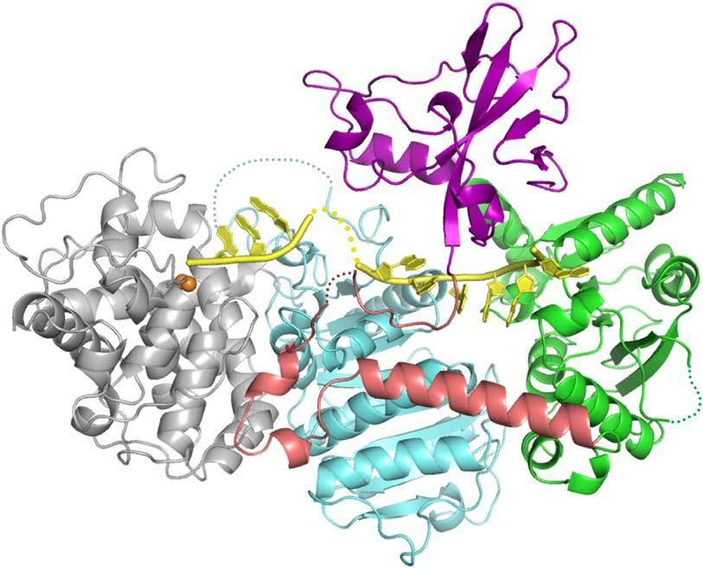


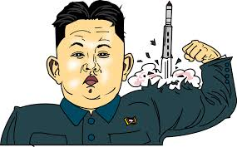

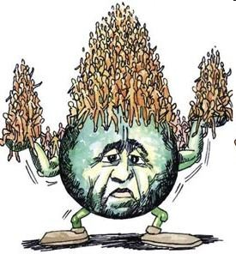

Cons…
Very Complex. Needs High Level of accuracy. If Something goes wrong than Condition becomes worst than earlier .
Wrong Usage Of Technollogy would be harmful for whole Humanity
Immortality leaqds towards Over Population
UnEthical

Slide 37


We hope…

Slide 38


My Contribution…
HIV Preventing Techniques
Treatment as prevention (TasP) for HIV :-
1. Prevention of mother-to-child transmission (PMTCT)
2. Pre-exposure prophylaxis (PrEP)
3. Microbicides
4. Post-exposure prophylaxis (PEP)
Test and treat strategies
Limitations of treatment as prevention
The future of treatment as prevention
Gnome Editing Techniques :-
1. ZFNS(zinc-finger nucleases)
2. TALENs(Transcription activator-like effector nucleases)
- Pros and cons of CRISPR

Slide 39

Hope you liked the video….

